Slide 1
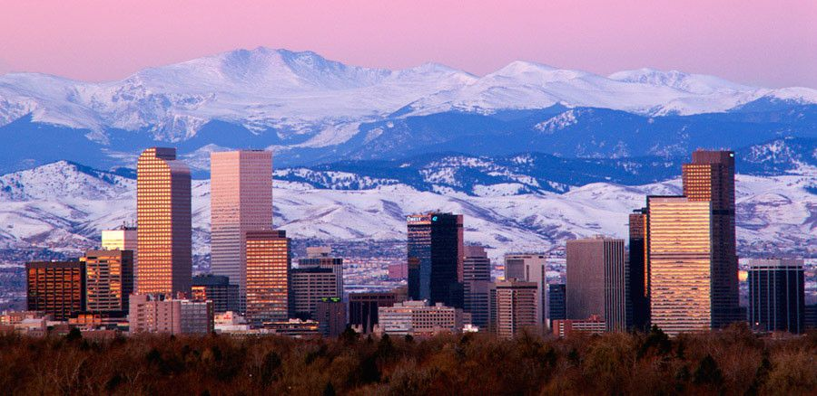
crime and health in the mile high city correlations in crime and health outcomes by neighborhood in Denver, co
Naureen Bharwani
Sean Mulligan
Cody Thornton

Slide 2
Project Description
We intend to explore the intersection of crime and health in Denver, CO with an emphasis on comparing neighborhoods and their demographic characteristics in the city. In doing so, we hope to shed light on what crimes occur where, and whether there is a measurable correlation between the rates of these crimes and health outcomes as measured by metrics like obesity, diabetes, and life expectancy. We also wish to look at how crime and health outcomes have changed over time, which may be related to events like the COVID-19 pandemic and the introduction of social programs like Denver’s Star Program.

Slide 3
Prior Work The Denver Department of Public Safety
The Denver Opportunity Index, an initiative by The Denver Department of Public Safety. [https://geospatialdenver.maps.arcgis.com/apps/MapSeries/index.html?appid=ff9da000f1a344beb341ce839a720021]
Key Takeaways:
There are significant, quantifiable differences between Denver neighborhoods in terms of financial security, access to education, transportation, and social and mental health services.

Slide 4
Prior Work The US Department of Housing and Urban Development
“Neighborhoods and Violent Crime”, a study by the U.S. Department of Housing and Urban Development's (HUD's) Office of Policy Development and Research. [https://www.huduser.gov/portal/periodicals/em/summer16/highlight2.html]
Key Takeaways:
Exposure to violent crime damages the health and development of victims, family members, and entire communities. Low-income people, racial groups, and ethnic minorities are disproportionately affected.
Violent crime is geographically concentrated in particular neighborhoods and in more localized areas known as hot spots; evidence suggests that problem-oriented policing of hot spots can be effective.
Strong social organization, youth job opportunities, immigration, and residential stability are among several neighborhood characteristics associated with lower crime rates.

Slide 5
Prior Work The National Institutes of Health
“Violence Exposure in Multiple Interpersonal Domains: Cumulative and Differential Effects”, a study available through the National Institutes of Health.
[https://www.ncbi.nlm.nih.gov/pmc/articles/PMC2907247/]
Key Takeaways:
Exposure to violence significantly contributes to academic failure, depressive symptoms and anxiety.
High cumulative violence increases the risk of comorbid symptoms and stress-related diseases including hypertension.

Slide 6

Datasets
We will use datasets from the City of Denver’s Open Data Catalog initiative which provides open access to data managed by the City and County of Denver. These datasets are available at:
https://www.denvergov.org/opendata/.
We will utilize GitHub for version control. As such, all datasets will be simultaneously available to all team members via a shared repository. To maintain the repository and prevent merge conflicts, we will utilize the Kanban style app Trello for project management. Our base file type will be comma separated value(CSV) files.

Slide 7
Datasets
We intend to focus on the following datasets:
1. Crime in the City of Denver
2. Hate Crimes in the City of Denver
3. Traffic Accidents in the City of Denver
4. Police Pedestrian Stops and Vehicle Stops in the City of Denver
5. American Community Survey in the City of Denver
6. Life Expectancy 2010 - 2015 in the City of Denver
7. Adult Obesity 2014-2016 in the City of Denver
8. Adult Diabetes 2010-2016 in the City of Denver
9. Real Property Sales and Transfers in the City of Denver

Slide 8
Datasets
Direct Links:
1. https://www.denvergov.org/opendata/dataset/city-and-county-of-denver-crime
2. https://www.denvergov.org/opendata/dataset/hate-crimes
3. https://www.denvergov.org/opendata/dataset/city-and-county-of-denver-traffic-accidents
4. https://www.denvergov.org/opendata/dataset/city-and-county-of-denver-police-pedestrian-stops-and-vehicle-stops
5. https://www.denvergov.org/opendata/dataset/city-and-county-of-denver-american-community-survey-nbrhd-2013-2017
6. https://www.denvergov.org/opendata/dataset/city-and-county-of-denver-life-expectancy-2010-2015
7. https://www.denvergov.org/opendata/dataset/city-and-county-of-denver-adult-obesity-2014-2016
8. https://www.denvergov.org/opendata/dataset/city-and-county-of-denver-adult-diabetes-2010-2016
9. https://www.denvergov.org/opendata/dataset/city-and-county-of-denver-real-property-sales-and-transfers

Slide 9
Proposed Work Getting Started
Review all datasets to understand the universe of attributes and how these attributes compare with one another.
Neighborhoods will be the primary attribute that we intend to join datasets on. Accordingly, we will need to verify that all datasets have comparable neighborhood attributes.
We will begin to explore the data using simple metrics like comparing counts of attribute occurrences, calculating medians and maximums, etc. We will also create simple plots to explore the data for initial interesting patterns.

Slide 10
Proposed Work Data Cleaning
As we explore the data, we will do our best to ensure data quality by viewing it through the lens of our textbook’s suggested criteria: accuracy, completeness, consistency, believability, and interpretability.
As part of our data exploration, we hope to identify and remove outliers and “messy” or “noisy” data objects.
Different datasets cover different time periods so we will need to strategize how to deal with this.
These are “living datasets” that are updated regularly so more recent data may have problems with accuracy including possible “tuple duplication” discussed in our textbook on page 98.

Slide 11
Proposed Work Data Integration
We intend to integrate the datasets related to crime into a single dataset. In doing so, we will need to identify duplicate values (redundancy) and ensure that attributes from different datasets can be matched to one another in meaningful ways, a task referred to by our textbook as the “entity identification problem” (94).
Fortunately, we are unlikely to suffer from data value conflicts caused by different naming and measurement paradigms (like metric vs imperial, etc.) because all our datasets are coming from a single source, the City of Denver. However, we do need to be mindful of this possibility.

Slide 12

Tools
Python with NumPy and Pandas for data analysis and manipulation
matplotlib for plotting and data exploration
GitHub for collaboration
Trello for project management
Seaborn or Tableau for visualizations

Slide 13
Evaluation
We seek to understand correlations between geography, socioeconomic indicators, crimes, and health outcomes. Initially, we will likely apply correlation analysis to our data. For nominal data we will use the chi-square test. For numeric data we will use the correlation coefficient and covariance. These measurements will help us to understand whether different attributes are dependent or independent variables. We also anticipate developing association rules that describe the relationship between correlated attributes. We will therefore likely rely on measuring support and confidence to evaluate the interestingness of our proposed rules. Finally, naive Bayesian analysis could help us to predict the likelihood of certain crimes and health outcomes occurring in specific neighborhoods.

